Slide 1
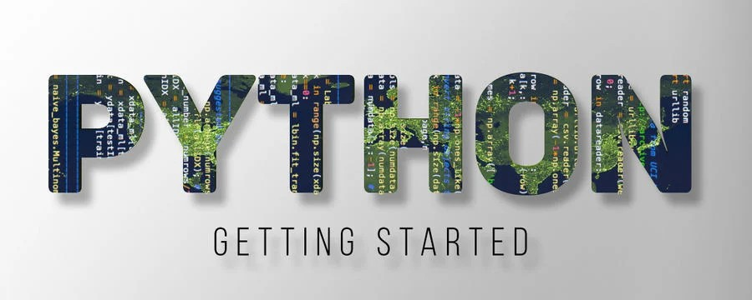
Presented By : Tauovir Khan

Slide 2
Python
Python is an interpreted, object-oriented, high-level programming language with dynamic semantics.
its high-level built in data structures, combined with dynamic typing and dynamic binding, make it very attractive for Rapid Application Development.
Python is a general-purpose language, meaning it can be used to create a variety of different programs and isn’t specialized for any specific problems
Python is a cross-platform programming language, which means that it can run on multiple platforms like Windows, macOS, Linux,
Python used for:
Web development
System Programming.
Building GUI application.
Internet scripting
Machine learning
Robotics programming.

Slide 3
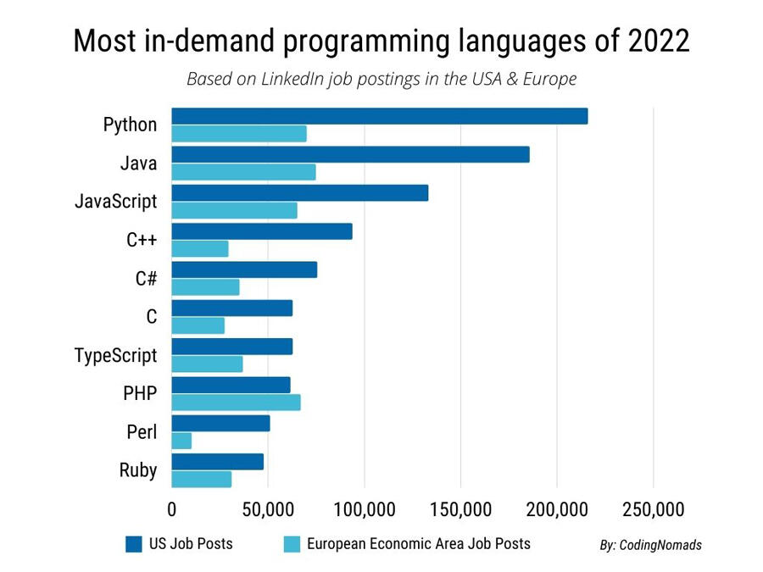
Python

Slide 4
Reason for Popularity
Free
Software Quality
Developer Productivity
Program portability.
Support libraries
Component integration.
Who Uses Python today?
Google in web search.
NASA- scientific programming.
iRobot : Commercial robot vaccum cleaners.
Intel, HP, IBM , etc

Slide 5
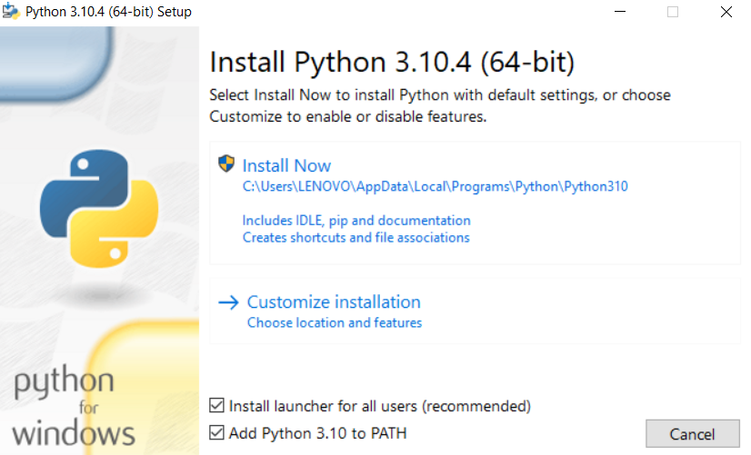
Install Python - 3
Download the latest version of python.

Slide 6
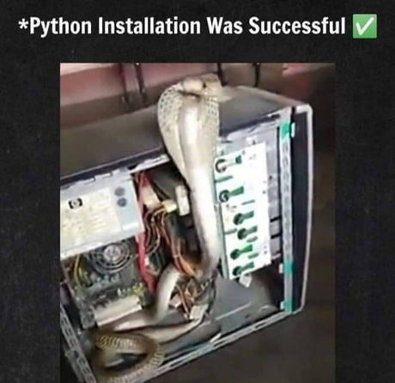

Slide 7
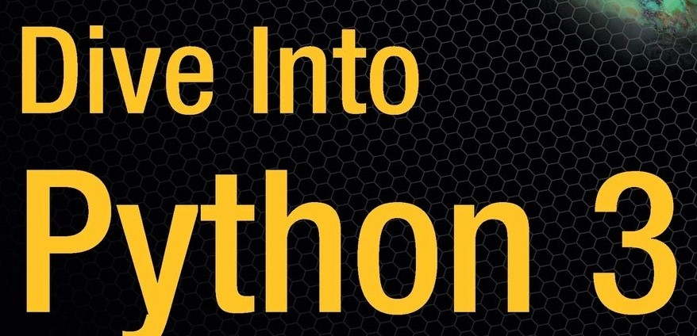

Slide 8
Exercise
Python Shell:
start the Python interpreter and display some messages.
Print 20 times “python3” word. (Hint: use *)
In the python shell define some variables and print their values and datatypes.
Display number from 1-100 in python shell (Hint : range())
Initialize two variables x, y. Perform addition, subtraction, multiplication
Programs in File:
start the Python interpreter and display some messages.
Print 20 times “python3” word. (Hint: use *)
In the python shell define some variables and print their values and datatypes.
Display number from 1-100 in python shell (Hint : range())
Initialize two variables x, y. Perform addition, subtraction, multiplication

Slide 9
Thank You

